Slide 1
Message Oriented communication

Slide 2
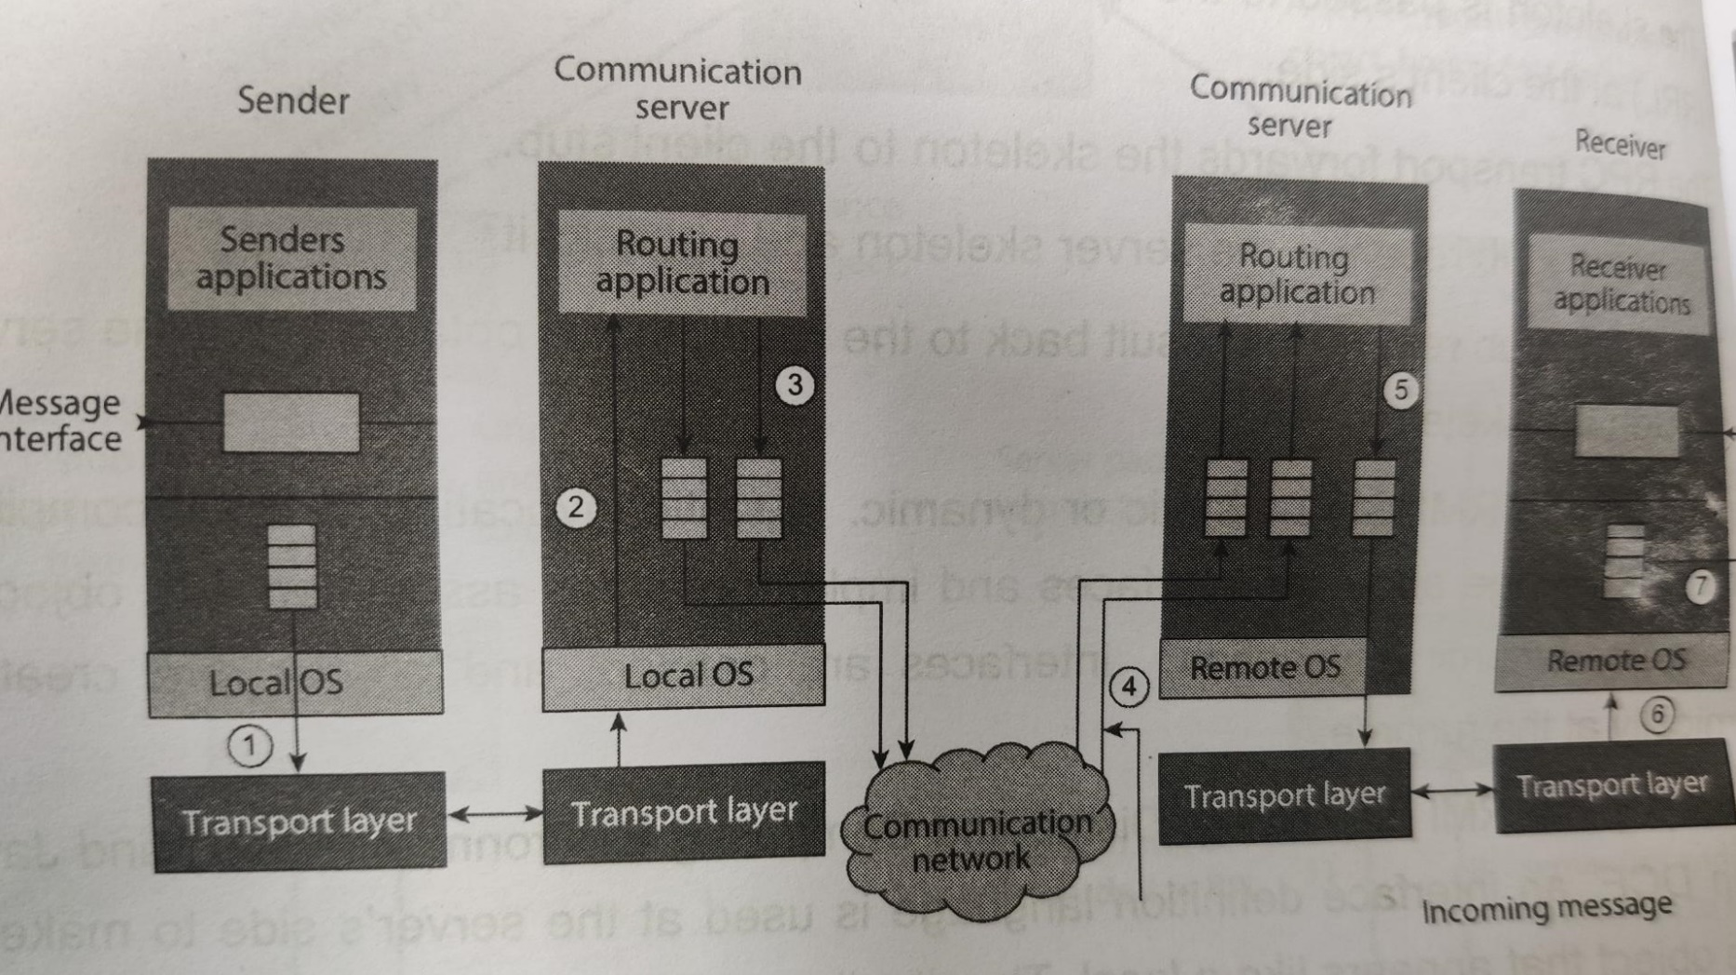
MOC:
Asynchronous Example: E-mail

Slide 3
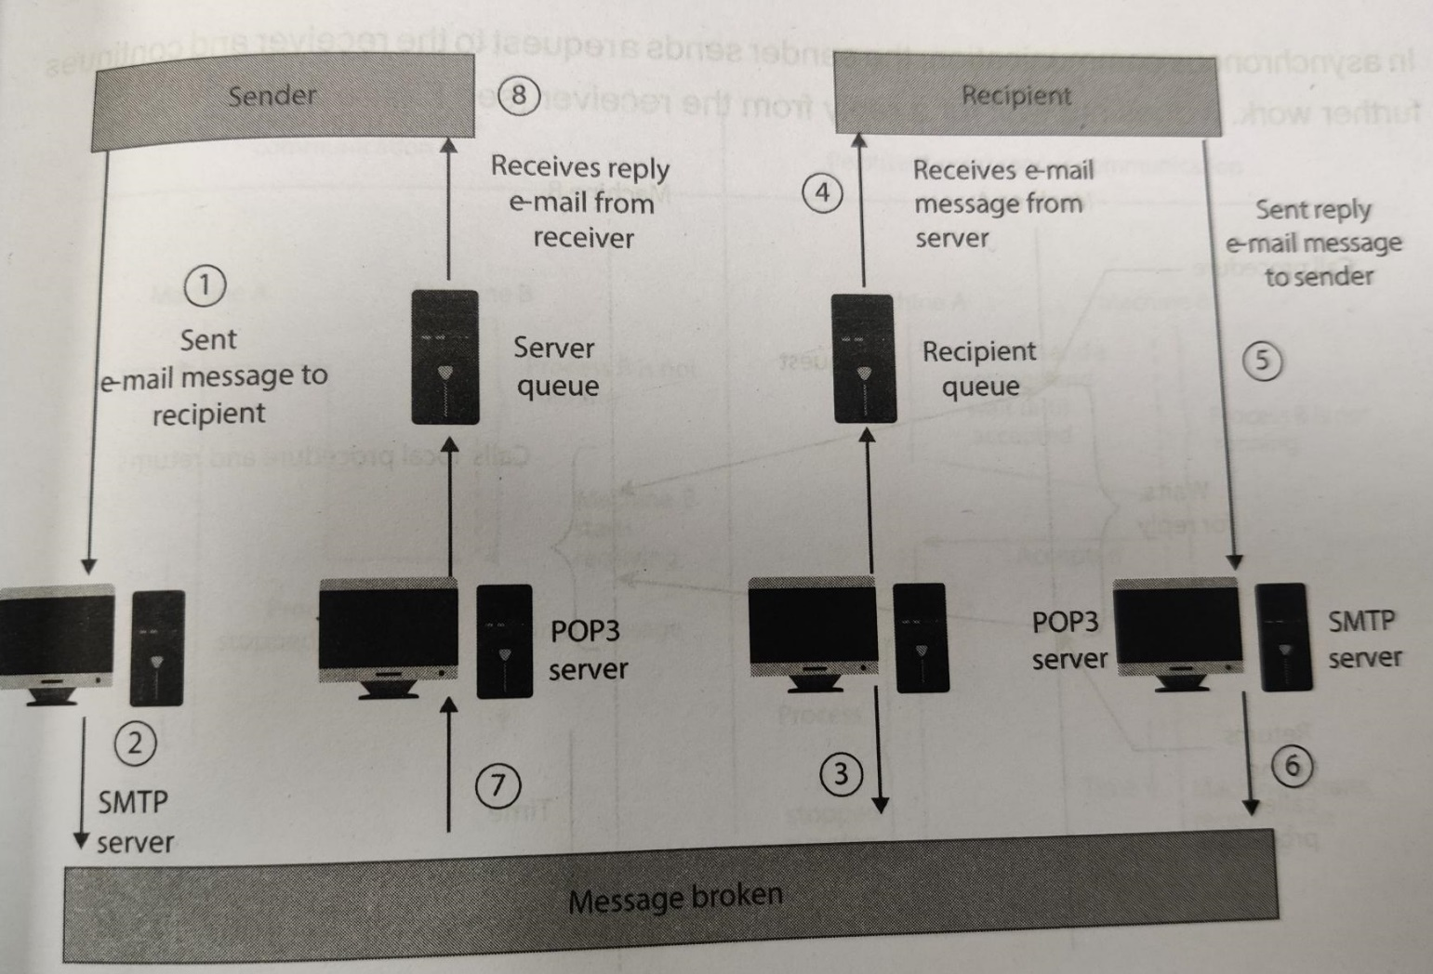
E-mail system Queue

Slide 4
Types of communication:
Persistency and synchronicity in MOC
Persistent and transient
Synchronous and asynchronous
Persistent synchronous and Persistent asynchronous
Transient synchronous and Transient asynchronous

Slide 5
Types of communication:
• Persistence: Persistence means that the network is capable of storing messages for an arbitrary period of time until the next receiver is ready. Eg: Email
• Transient: Message is stored only so long as the next receiver is ready. i.e. when both sender and receiver are running. The system will not store the message and discards if it can not be delivered to receiver. Since the message is transient, both entities have to be running.
For example, Transport- level communication discards the message if the process crashes for any reason.
• Asynchronous: Asynchronous communication means that the sender is doing non-blocking sending. It continues immediately after submitting the message.
• Synchronous: Synchronous communication blocks the process until the message is received or the sender gets a response from the server.
Eg:
Persistent synchronous: The sender is blocked when it sends the message, waiting for a acknowledgement to come back. The message is stored in a local buffer, waiting for the receiver to run and receive the message.
Some instant message applications, such as Blackberry messenger, are good examples. When you send out a message, the app shows you the message is ”delivered” but not ”read”. After the message is read, you will receive another acknowledgement.
Transient asynchronous: (sockets) UDP

Slide 6
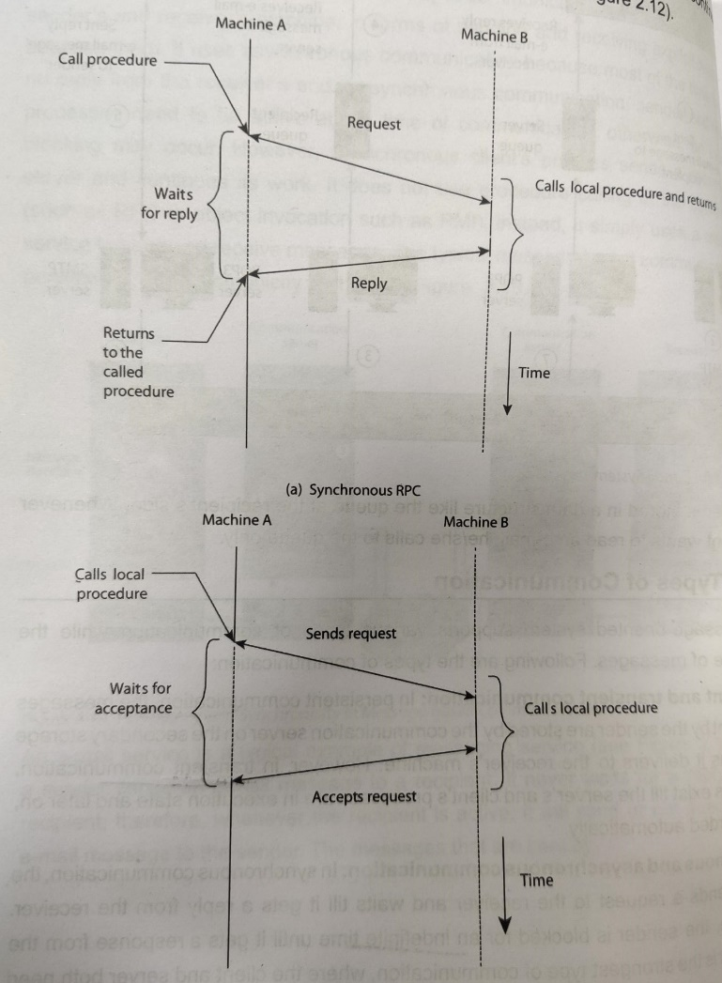
Synchronous vs Asynchronous

Slide 7
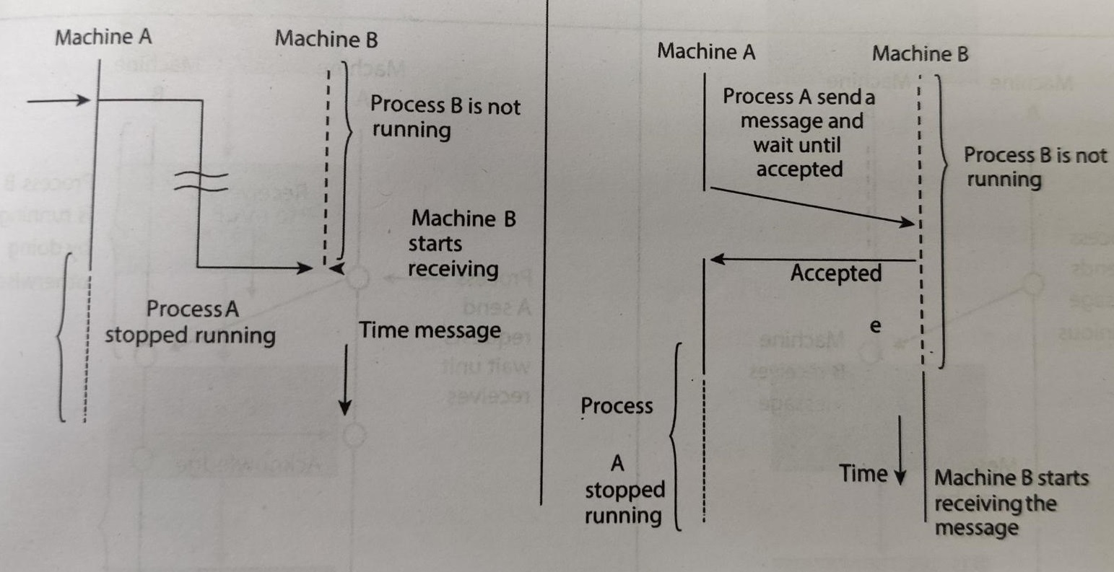
Synchronous vs Asynchronous: persistent

Slide 8
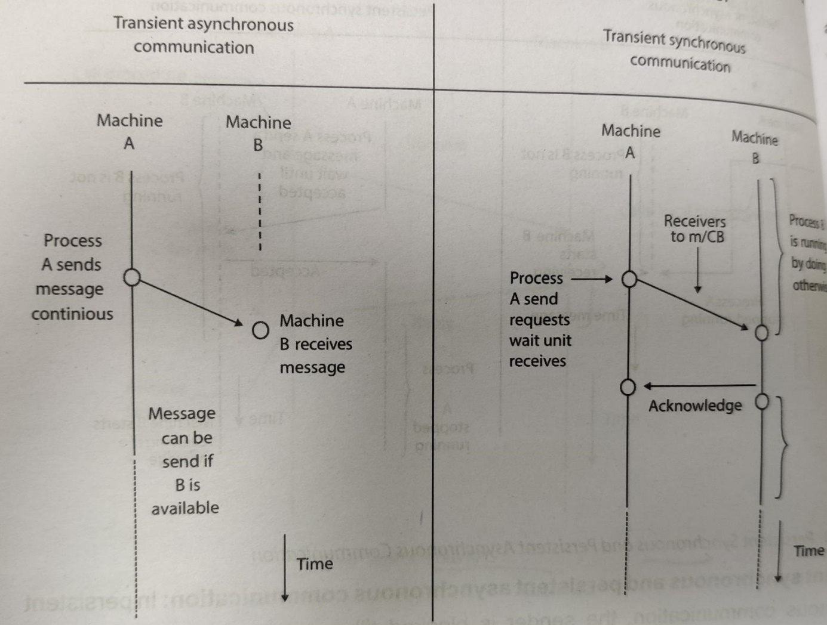
Synchronous vs asynchronous: Transient

Slide 9
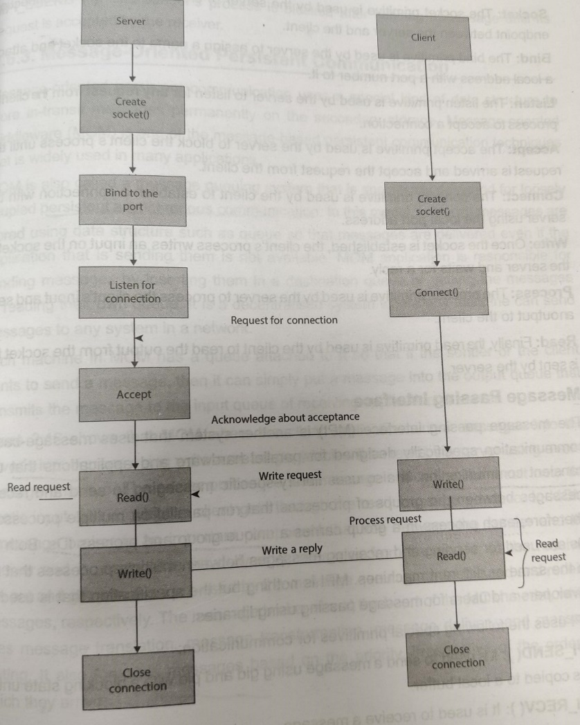
Transient: Sockets and MPI
Socket: Bind, Listen, Accept, Connect, Read, Write, Close
MPI: MPI_send(), MPI_recv(), MPI_bsend(), MPI_sendrecv(), MPI_ssend()

Slide 10
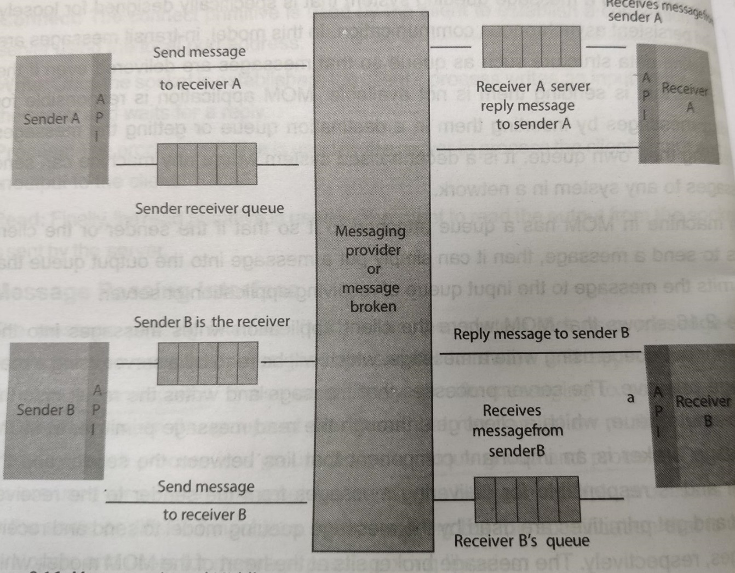
Message oriented persistent: Mo-middleware( MOM/queuing)
Persistent asynchronous
Message broker
Traslation
Transformation
Delivery
Routing
Priority

Slide 11
Group communication
One to many:
Multiple receivers single sender
Multicast, broadcast:
Eg: locating a service
Group management: closed and open
Group addressing: Two level naming scheme
High level: ASCII string
Low level: hardware
Buffered and unbuffered
Flexible reliability: 0(No response), 1(anyone), m out of n, all
Atomic multicast: All or none

Slide 12
Group communication
Many to one: Selective/ non selective
Many to many:

Slide 13
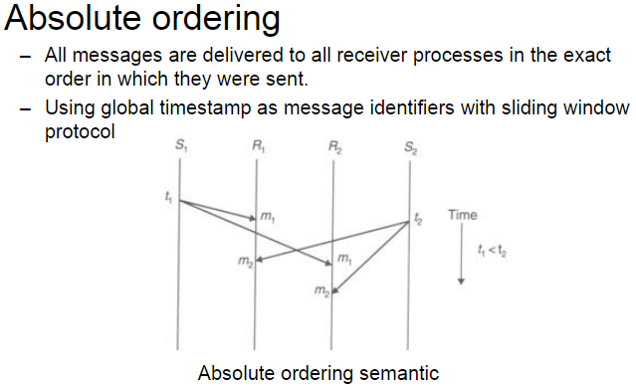

Slide 14
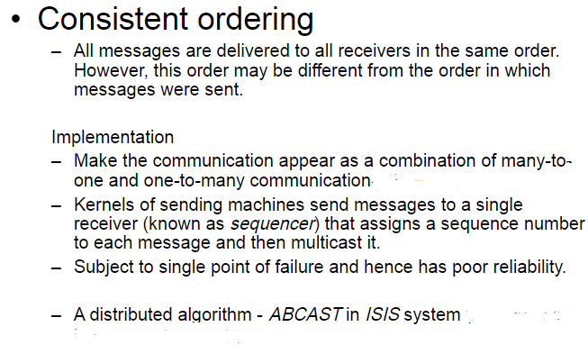
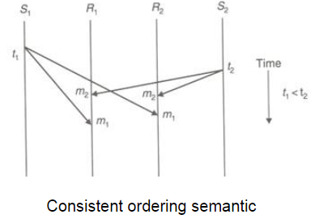

Slide 15
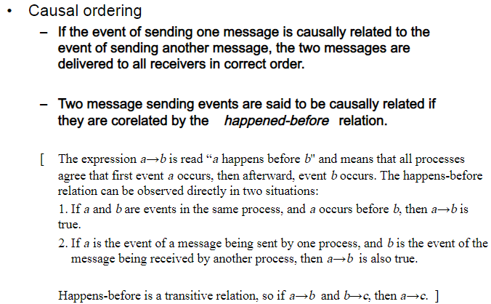

Slide 16
